Slide 1


BRAIN SCAN TUMOR CLASSIFICATION
Authors: Alyson Suchodolski, Sabrina Wang, Trevor Nims, Vanessa Hsu, Aaliyah Hänni, Jordan Fields
Date: 3/16/2021

Slide 2

PROJECT OVERVIEW
For this project, we are using a 2D Convolutional Neural Network with nine hidden layers to classify 2D MRI brain scan images as tumorous or non-tumorous. Our model was built with Tensorflow, utilizing the Keras API. Our model's input (data set is described in the "Data Description" tab) is composed of standardized 240x240x1 single-channel image arrays. After training, an image passed to the model will produce a prediction of either 1 (tumorous) or 0 (non-tumorous).
The purpose of this project is to create a machine learning model that diagnoses tumors in brain scan images. In a recent study done in the Journal of Clinical Oncology, 37% of the patients selected for a study has brain tumors that were misdiagnosed in MRI scans.
Source:Article tools. (n.d.). Retrieved March 16, 2021, from https://ascopubs.org/doi/full/10.1200/JCO.2017.76.4720

Slide 3

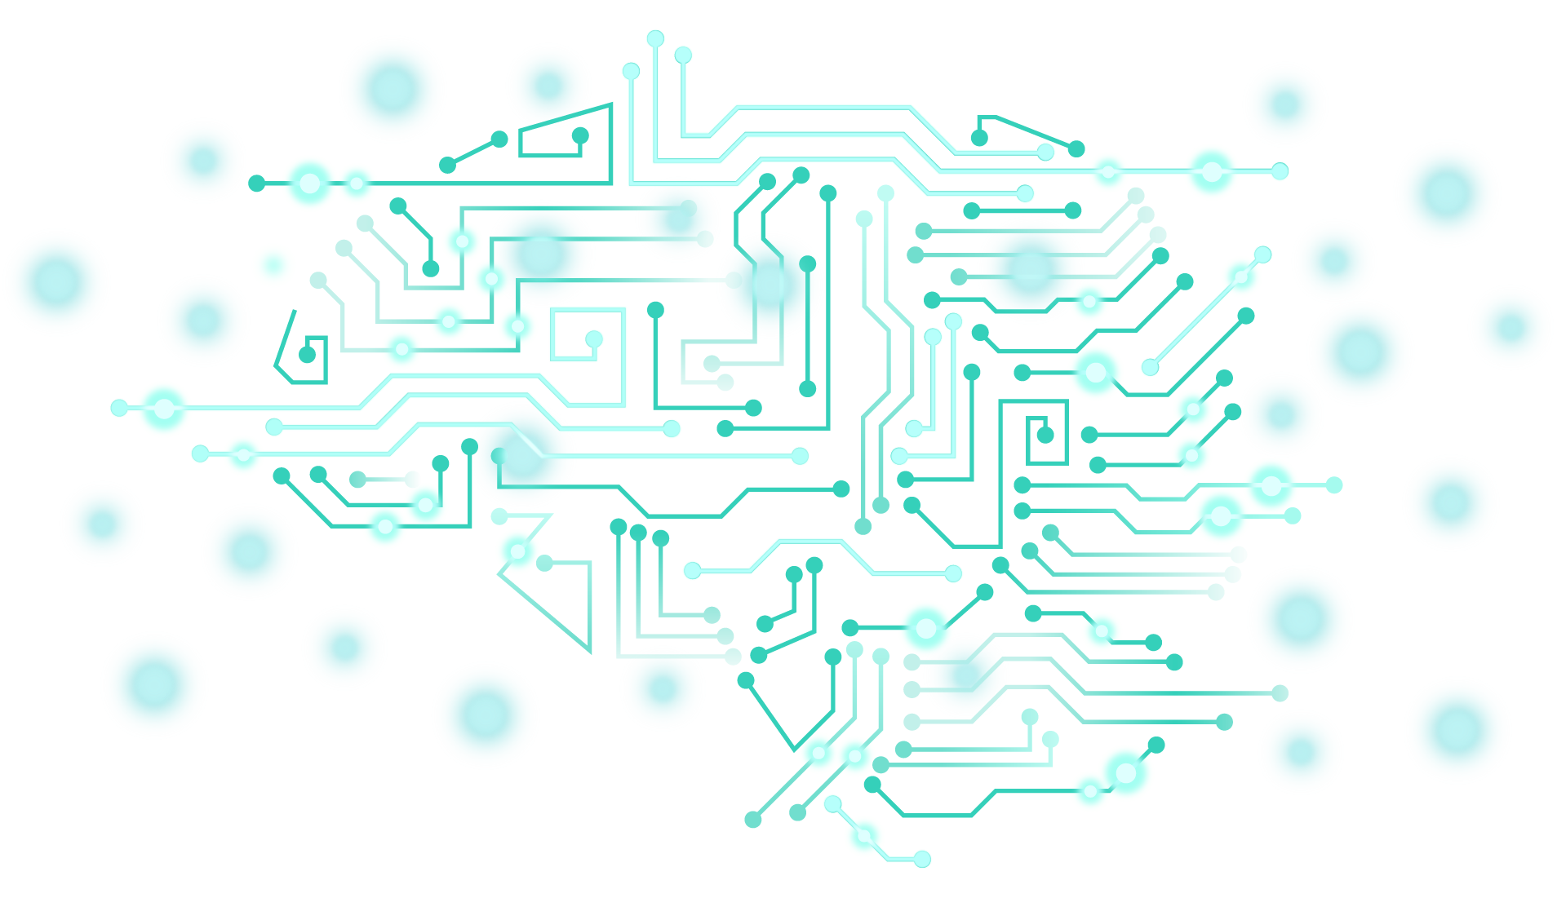
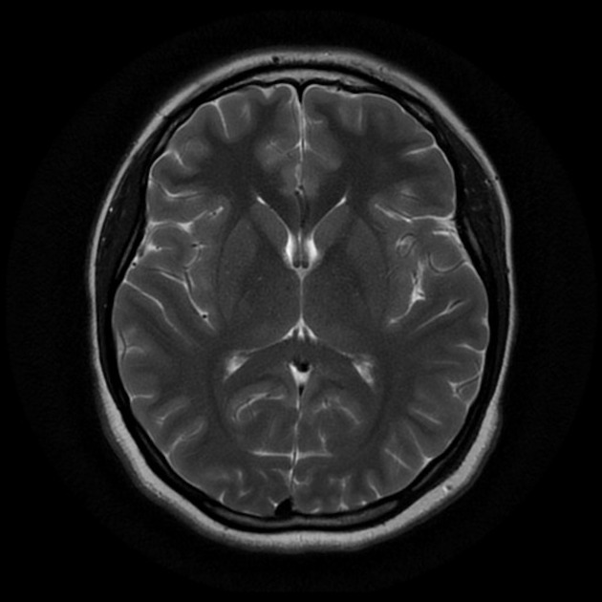
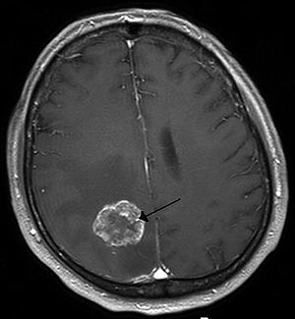
Brain Images Dataset
Dataset Source: https://www.kaggle.com/navoneel/brain-mri-images-for-brain-tumor-detection
98 Non-Tumorous Brain Scan Images
155 Tumorous Brain Scan Images

Slide 4

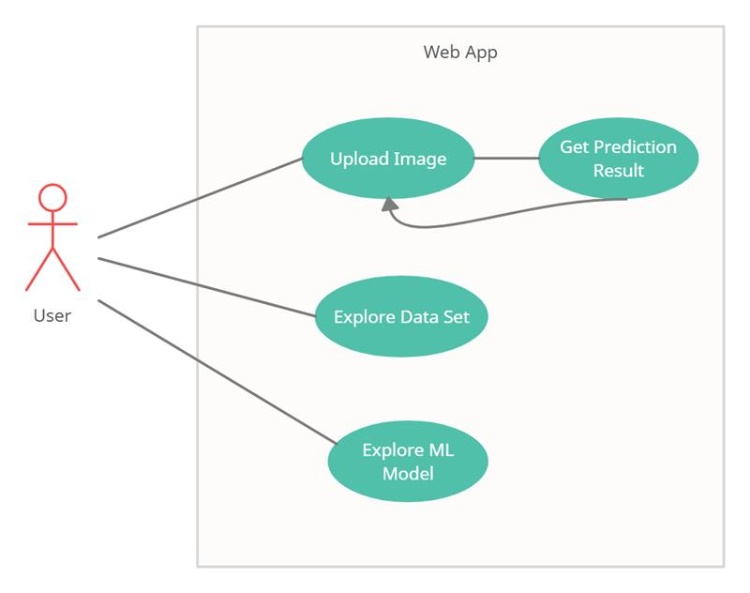
Use Cases
Use Case #1 (The Technician)
Detect if a tumor is present in an MRI image
Verify their own hypothesis of a tumor presence
Use Cases: #2 (The Medical Student)
Learn more about a machine learning model that categorizes brain scan images
Verify their own analysis with the model predictions of an MRI image

Slide 5
Project Demo
http://doihaveatumor.com

Slide 6
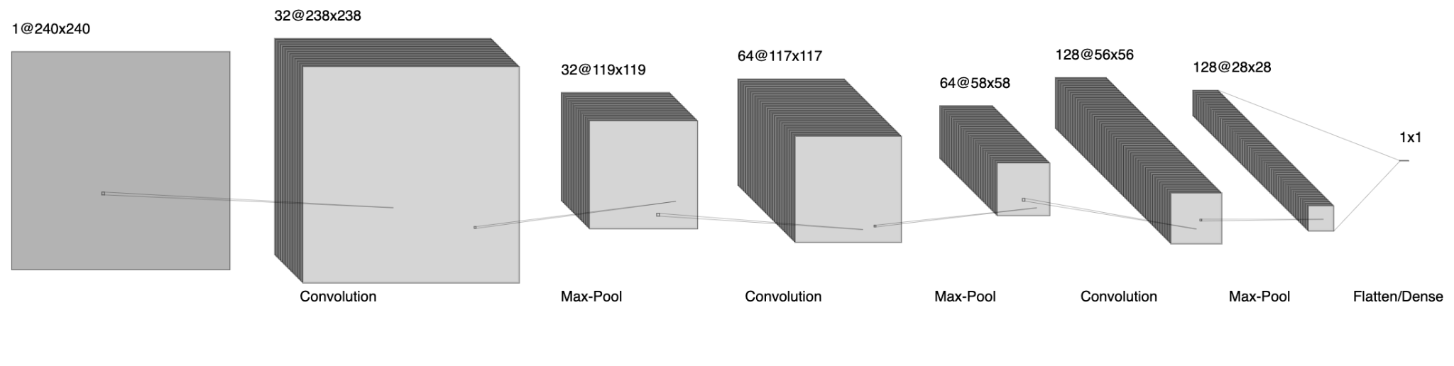
Project Design -- Machine Learning
2D convolutional neural network
9 hidden layers
Image augmentation

Slide 7
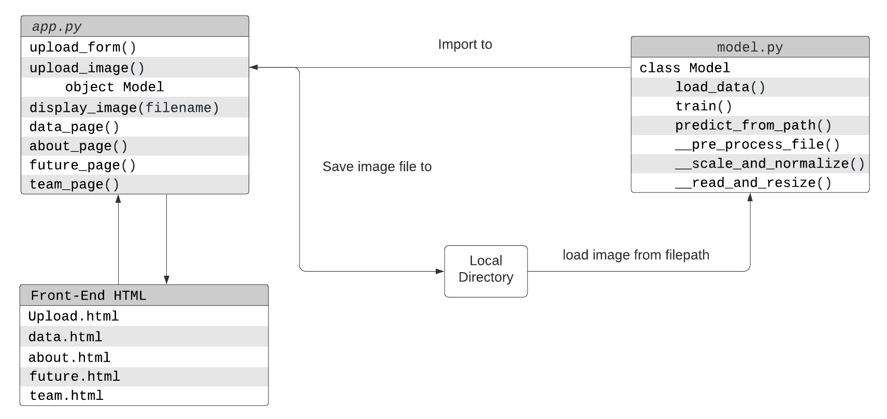
Project Design -- Flask Project
Flask is a micro web framework written in Python.
Handle the uploaded images and read the images for prediction
Redirect URL when switching among different navigation tabs

Slide 8
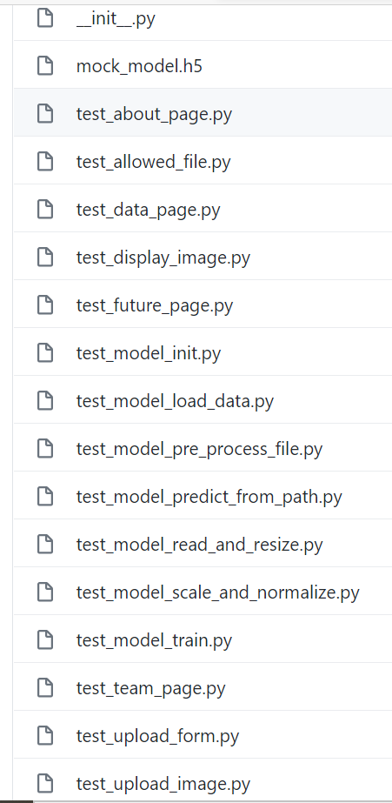
Project Design -- Unit Testing
15 unit tests were created to test our code
Coverage: ~90%
Tested the model, the prediction, and the application
Notes:
Alyson/Jordan (maybe)

Slide 9
GitHub Demo
https://github.com/aaliyahfiala42/DATA515-Brain-Scan-Classification

Slide 10
Lessons Learned
Machine Learning requires a dedicated GPU
Python Anywhere does not allow Tensorflow models
Documentation takes a long time to complete and continuously update

Slide 11
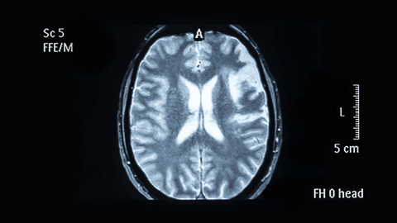
Future Work
Rebuild our model to be trained on 3D MRI Images
Continue to improve performance of the model

Slide 12

THANK YOU!!!

